Slide 1

Notes:
Aim is just to introduce them to the lab staff and get them comfortable talking in the space
Why are they here? What brought them here?
What is digital humanities for each of us? What was our own particular path into it
welcome to ask me or us questions as we go

Slide 2
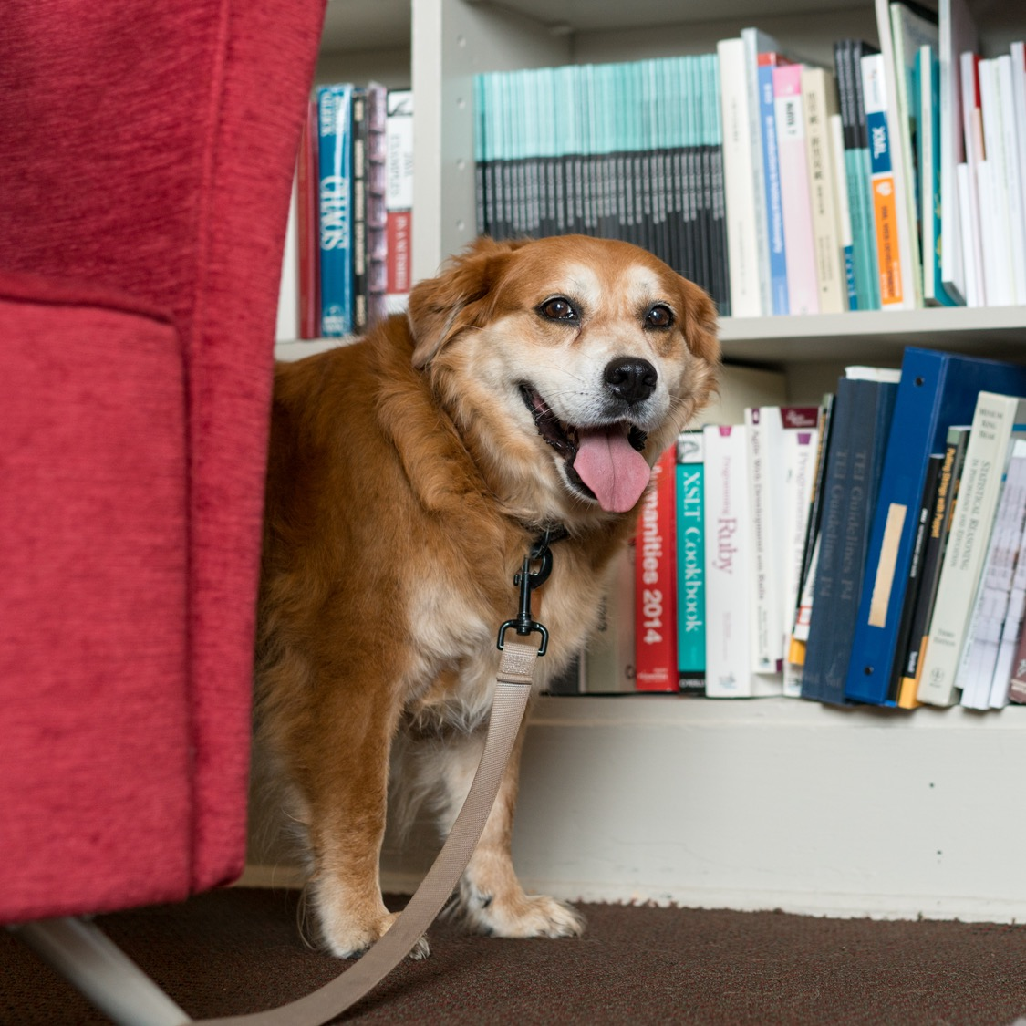
Introductions
Name
Department / what you do
Something else about you

Slide 3
Spaces and Expectations
We'll be online for the fall; very likely spring as well.
Make sure you have good Slack notifications set and engage if you can.
Up to date info here - praxis.scholarslab.org/curriculum/
Mostly set, but things get shifted around
10 hours a week / 3 hours in session together
Tuesdays from 1-2 and Thursdays from 1-3
Office Hours forthcoming
Note on working together
Accountable to each other
First and foremost, kindness and generosity
Notes:
Much of the ten hours is going to be taken up with

Slide 4
Financial Logistics
If you get paid, let me know
If you think you should get paid but haven't, let me know
If you so much as sense an ill wind about finances, let me know
Better to be redundant than to be delayed
A note on the GSAS portions of your fellowship
Let me know privately after session?
Notes:
We don't hear when things go wrong. We also don't hear when they go right. Let us know about everything.

Slide 5
phdplus.virginia.edu
Notes:
Explain program and pass out handbills

Slide 6
Other Scheduling Things
Be thinking about ways to maintain a community – details forthcoming
DH Fellows colloquium – dates forthcoming
Come to our events if you're able!
Notes:
We don't hear when things go wrong. We also don't hear when they go right. Let us know about everything.

Slide 7
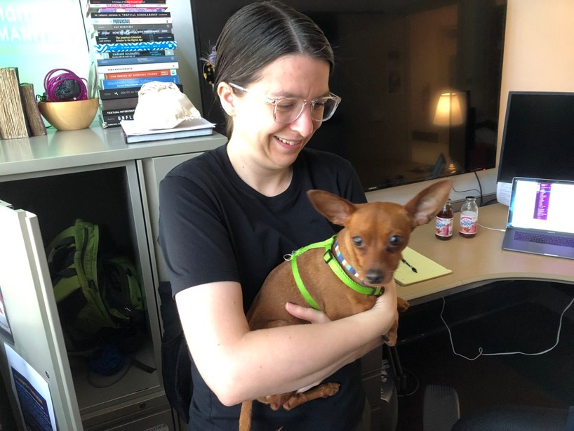
Code Camp
Technical training is its own track
Not to separate hacking from yacking, but to make sure both get time
Once per week
Allows us to go further
Give the "mic" to Shane

Slide 8
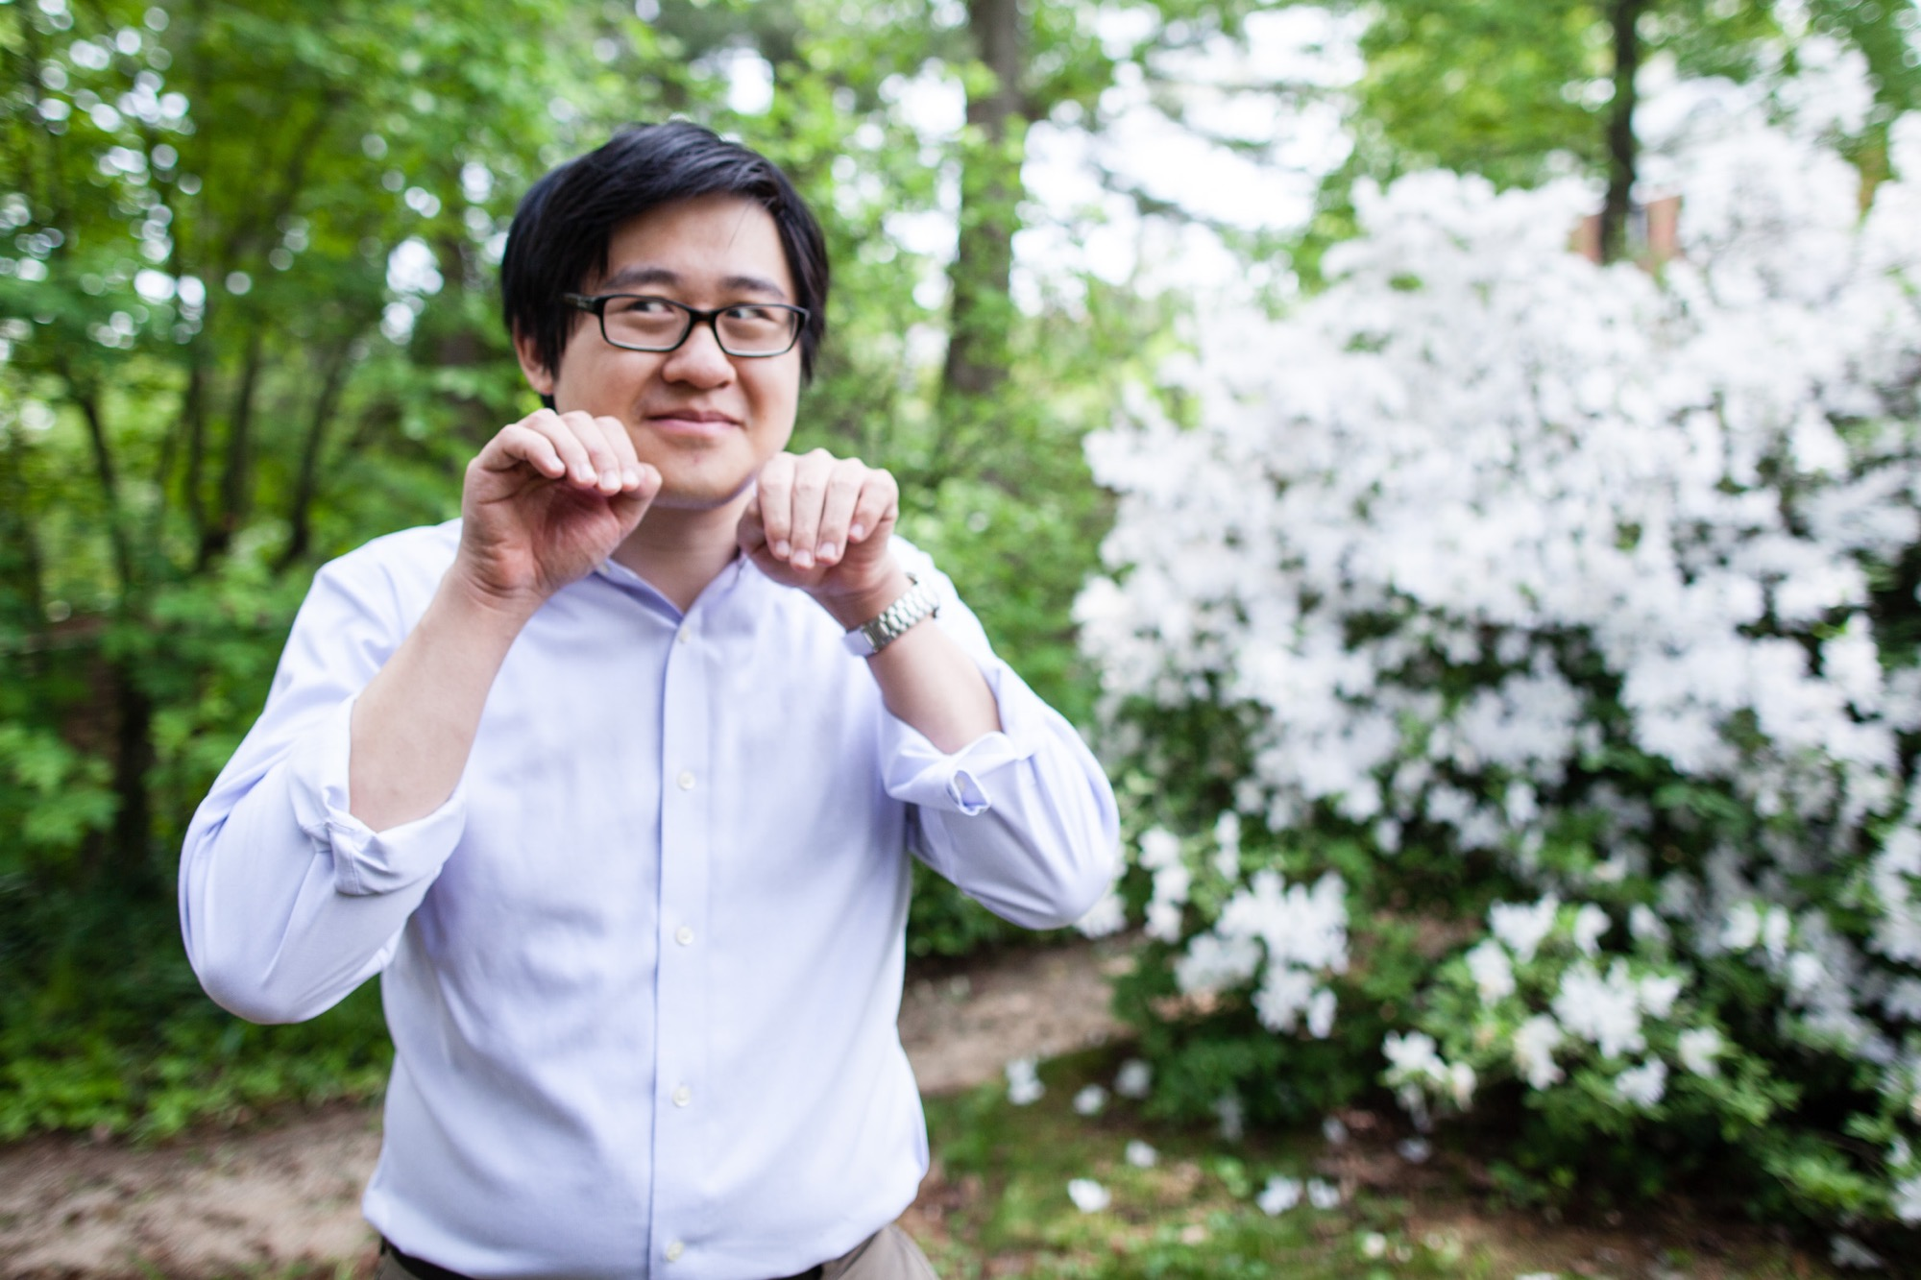
The World According to Shane (Head Shots)
Shane is our awesome photographer
Normally he would give you headshots; happy to do it if the world ever allows.
Reminder to share one if you already have one.

Slide 9
Blogging
Expected to blog semi-regularly
Aim for two each semester; feel free to do more.
For most of you, this will be unpleasant. That's ok!
A blog post can be anything you want it to be!
Check scholarslab.org for ideas
bit.ly/Slab-Blog-Docs
Start drafting now, and we'll work on a time for helping you

Slide 10
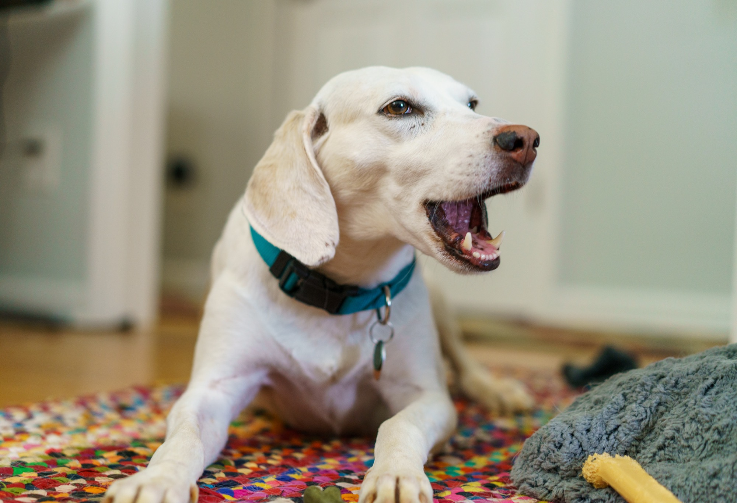

Slide 11
Slack
All invited to the Scholars' Lab slack
Feel free to make your own channels, but also good to be public
Anything we post you're welcome to chime in on
DH Slack - tinyurl.com/DHslack
Amanda thoughts?

Slide 12
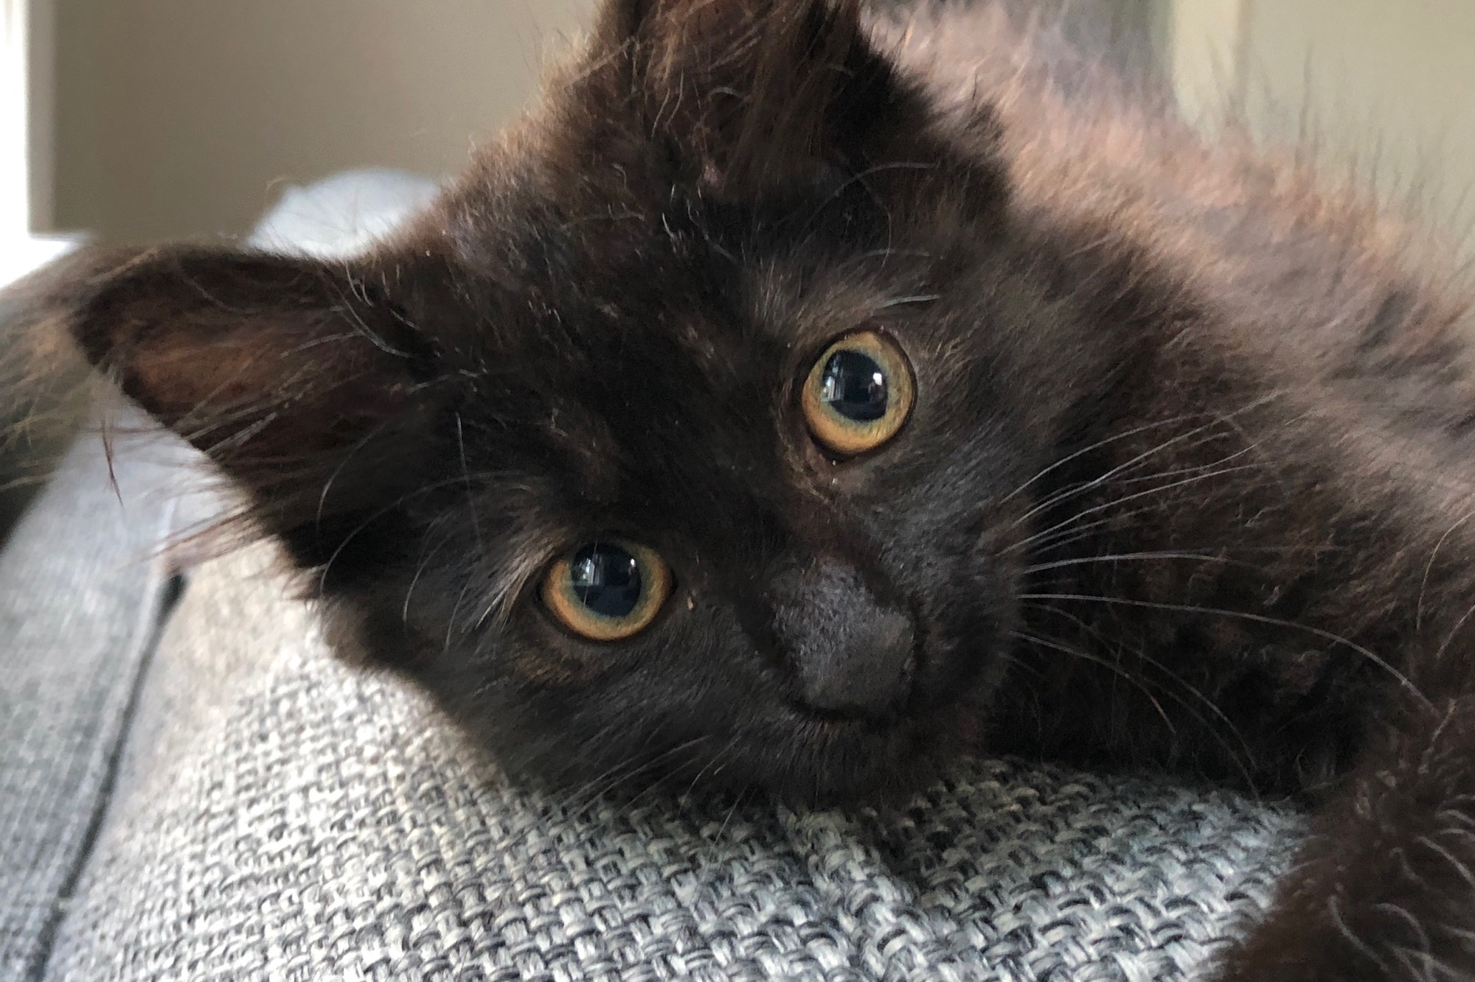

Slide 13
Models we've worked with
Year-long (or more) project where we give the thing, more or less
Prism – prism.scholarslab.org
Ivanhoe – ivanhoe.scholarslab.org
Pros
Intervention often feels more realized
Deep on a single technology
Predictable tech stack (easy to plan)
Cons
Students less invested
Students less empowered
Deep on a single technology
Notes:
The idea behind this is really that you're going to be doing stuff at the same time that you're thinking. Talking at the same time that you're working. Solo but mostly in various iterations of together.

Slide 14
Models we've worked with
Year-long project where we have the students generate the thing
Clockwork – clockwork.scholarslab.org
Dash-Amerikan - dashamerikan.scholarslab.org
UVA Reveal - reveal.scholarslab.org
Pros
Students are empowered
Some students are invested (the talkers)
Deep on a single technology
Cons
Difficult to support
Intervention less realized
Deep on a single technology
Most students still not invested

Slide 15
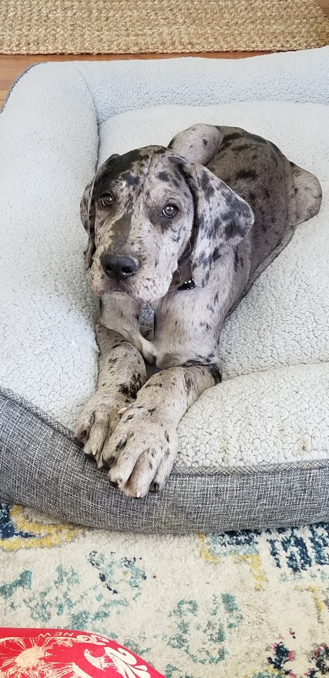
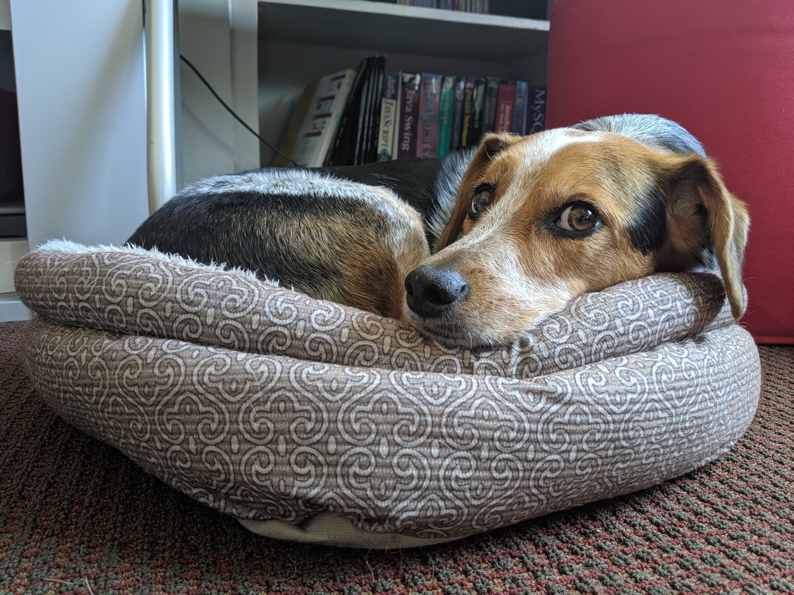

Slide 16
Now
Portfolio of experiences
Some more guided, some more independently grown
Fall
Three assignemnts – Charter, Workshop, Project Proposal
Various shades of group/independent/paired
Spring
Semester-long collaborative project that splits the difference b/w given and shaped
unclosure.scholarslab.org
landandlegacy.scholarslab.org

Slide 17
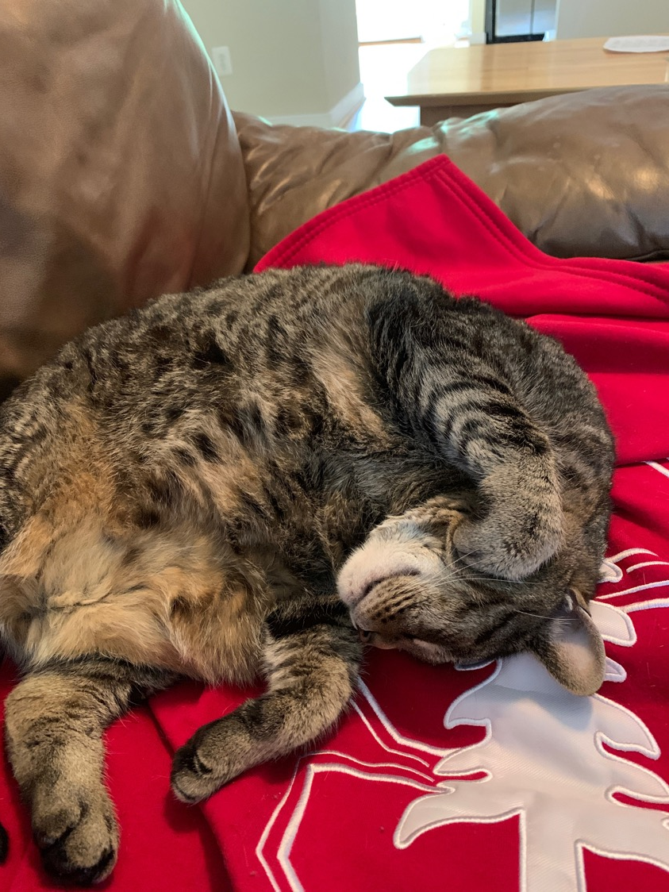
Fall Pt 1 - Charter
Group-authored statement
Values
Goals
Feelings
Ronda will share more

Slide 18
Fall Pt 2 - Workshop
Lightweight workshops, piloted together
Teaching to learn
Opportunities to share them at W&L
Also could have an audience here!
DH Roadshow

Slide 19
Fall Pt 3 - Project Proposal
Begin shaping plans for the spring together
Aim for an abstract /description and a project management plan before winter break
Also a chance to make a personal proposal for going further
Something to follow up on this year and in the future
Space to meet

Slide 21
Spring – Project Work
Project – DH Education and Equity
This is the tenth year of the program. Praxis was designed by people who are largely not here. So frame for the year is to take it back to its source. What do you believe grad education in DH should look like? Can look like? How can it be grounded in equity and inclusivity? What should it look like now, in 2020, with all the crises and urgencies that entails? More soon.
Potentially give your workshops
Public presentation on the group project in late May

Slide 22
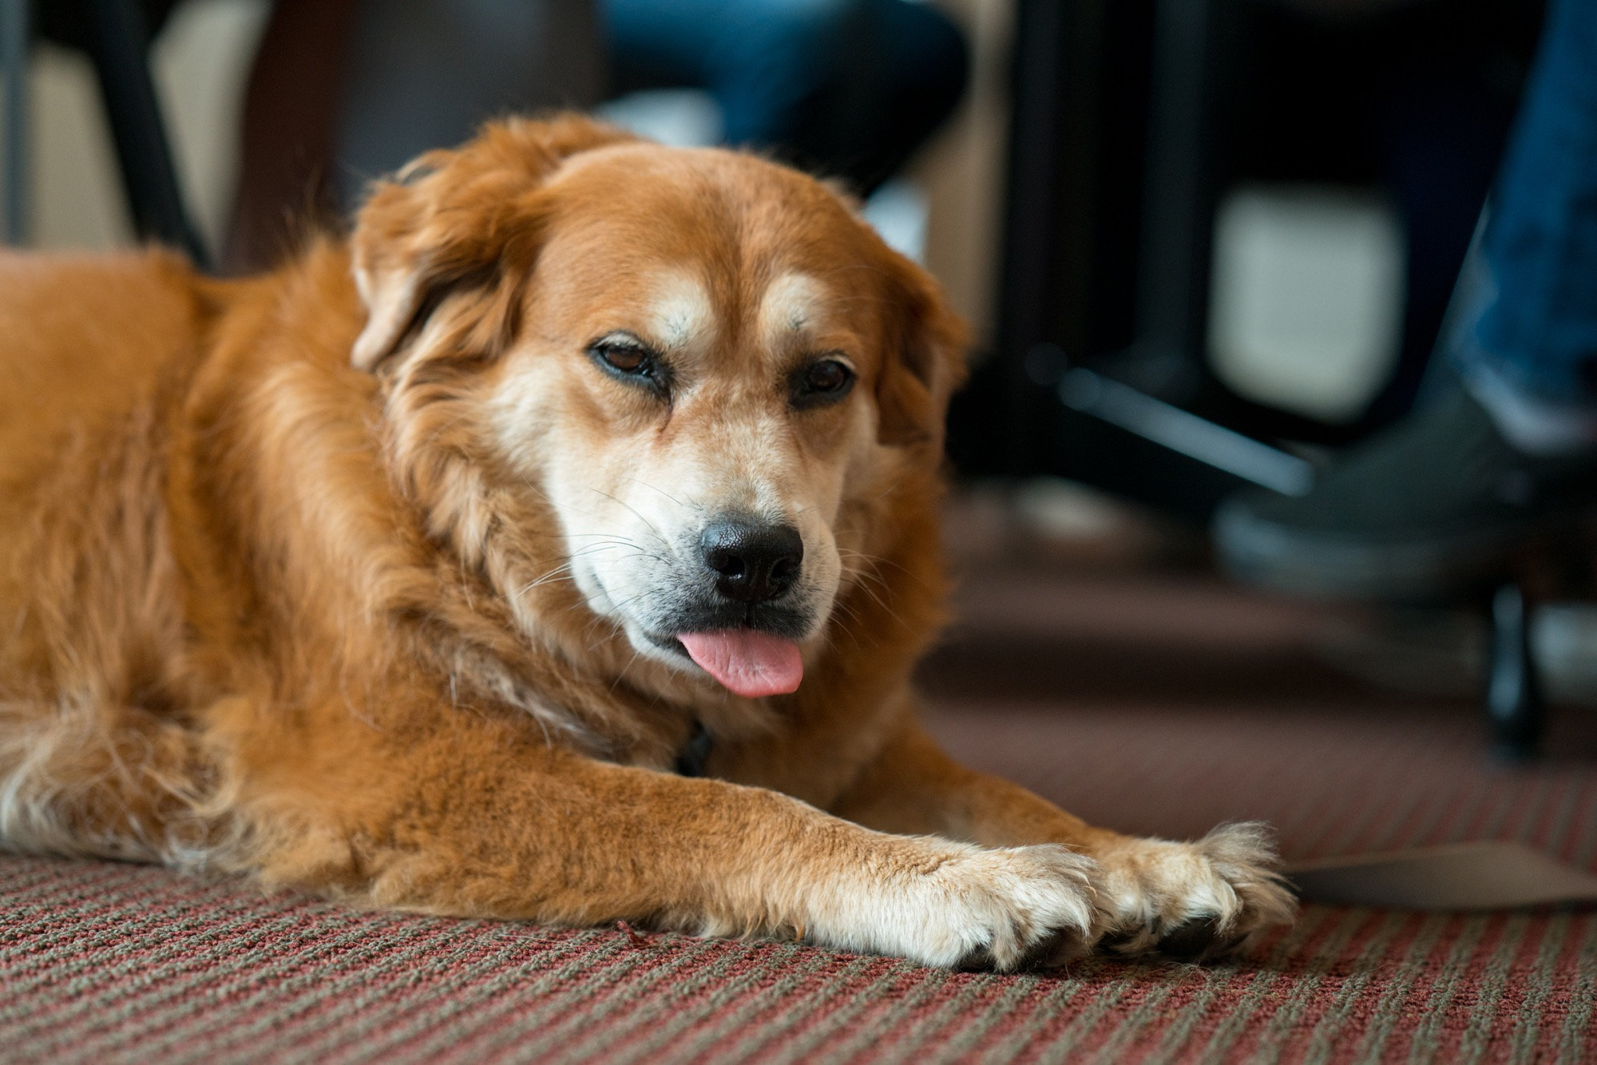

Slide 23
Questions and First Discussions
Notes:
Why are you here?
What do you want out of life? Who are you really?
What are some general reactions to the documents I circulated in advance

